Slide 1
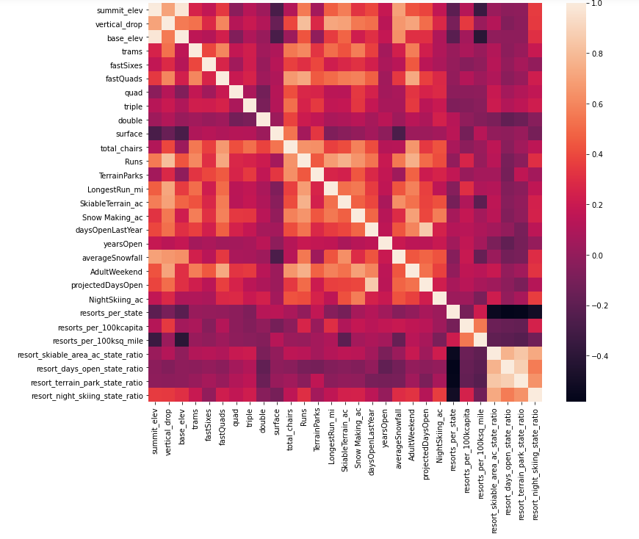
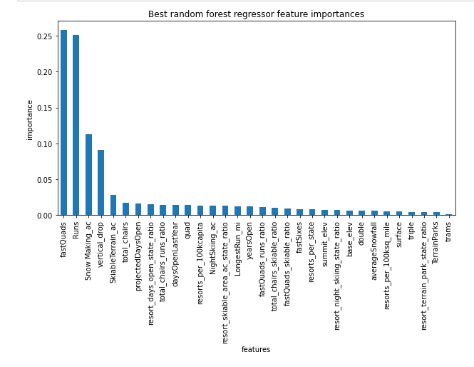
Guided Capstone Project Report
In order to survey current market options and provide a data-driven plan to derive a modified ticketing prices, the data was cleaned to drop null values and
ambiguous values. Total rows dropped from 330 to 2777 and weekend price was fixed as a target to optimize/study.
Combined with geographical/location data, two parameters namely resorts_per_100kcapita and resorts_per_100ksq_mile seemed relevant as that reduced the
number of variables through PCA. A heatmap showed relevance of showed influence of fastquads, Runs , snow_making_ac and resort_night_skiing_state_ratio
correlated with ticket price. Thus, the number of variables were reduced considerably.
Several regression models were tried on the major variables and multiple folds were re-created. The random forest model gave the best R-sq fit of 0.62 on training data
and 0.79 on test data.
Based on random forest model, Big Mountain Resort modelled price is 95.87 where in the current ticket price is 81.00. Among all the options that the management want to pursue,
the most beneficial is adding a vertical drop of 150 feet and adding a chair car. The ticket price can be increased 8.61 to cover for the additional operating cost.
However, resulting increase in revenue is predicted to be >15 million.
PCA heat-map
The four dominant features were found to be 1. fastQuad, 2 Runs, 3. snow_making_ac, 4.vertical_drop

Slide 2
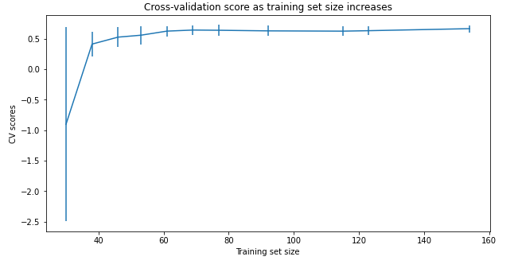
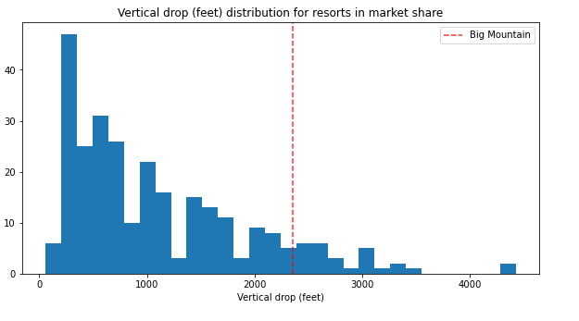
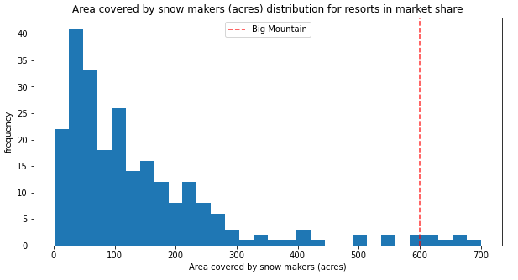
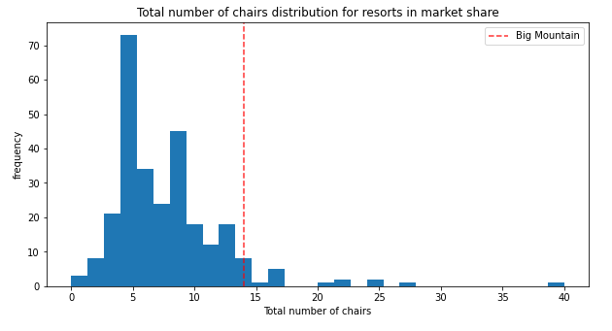
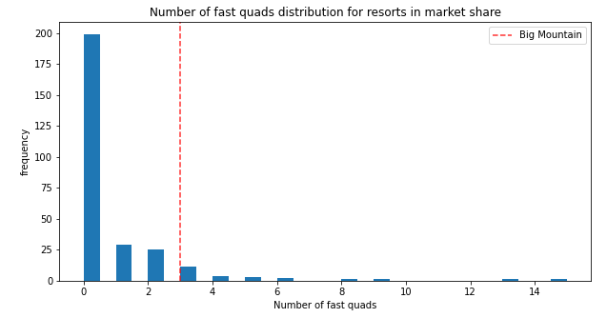
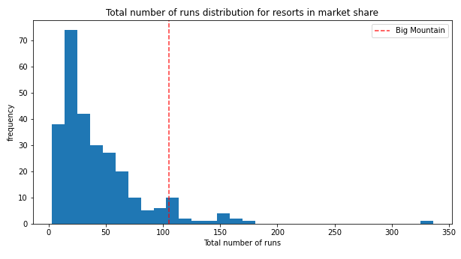
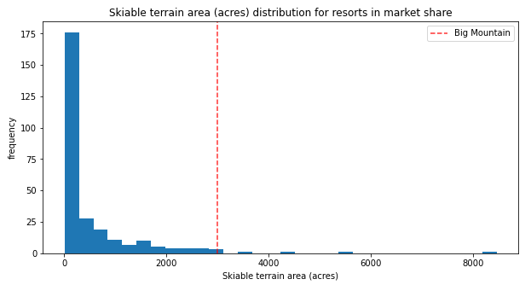
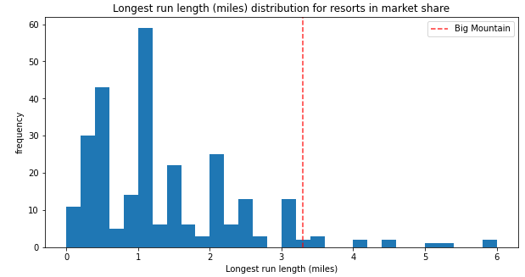
Cross-validation shows CV scores level off at 50-60 sample size
Big mountain fares very well on vertical drop, snow-area, chairs, fastQuads, runs, longest run length and skiable_terrain
compared to other resorts.

